Slide 1
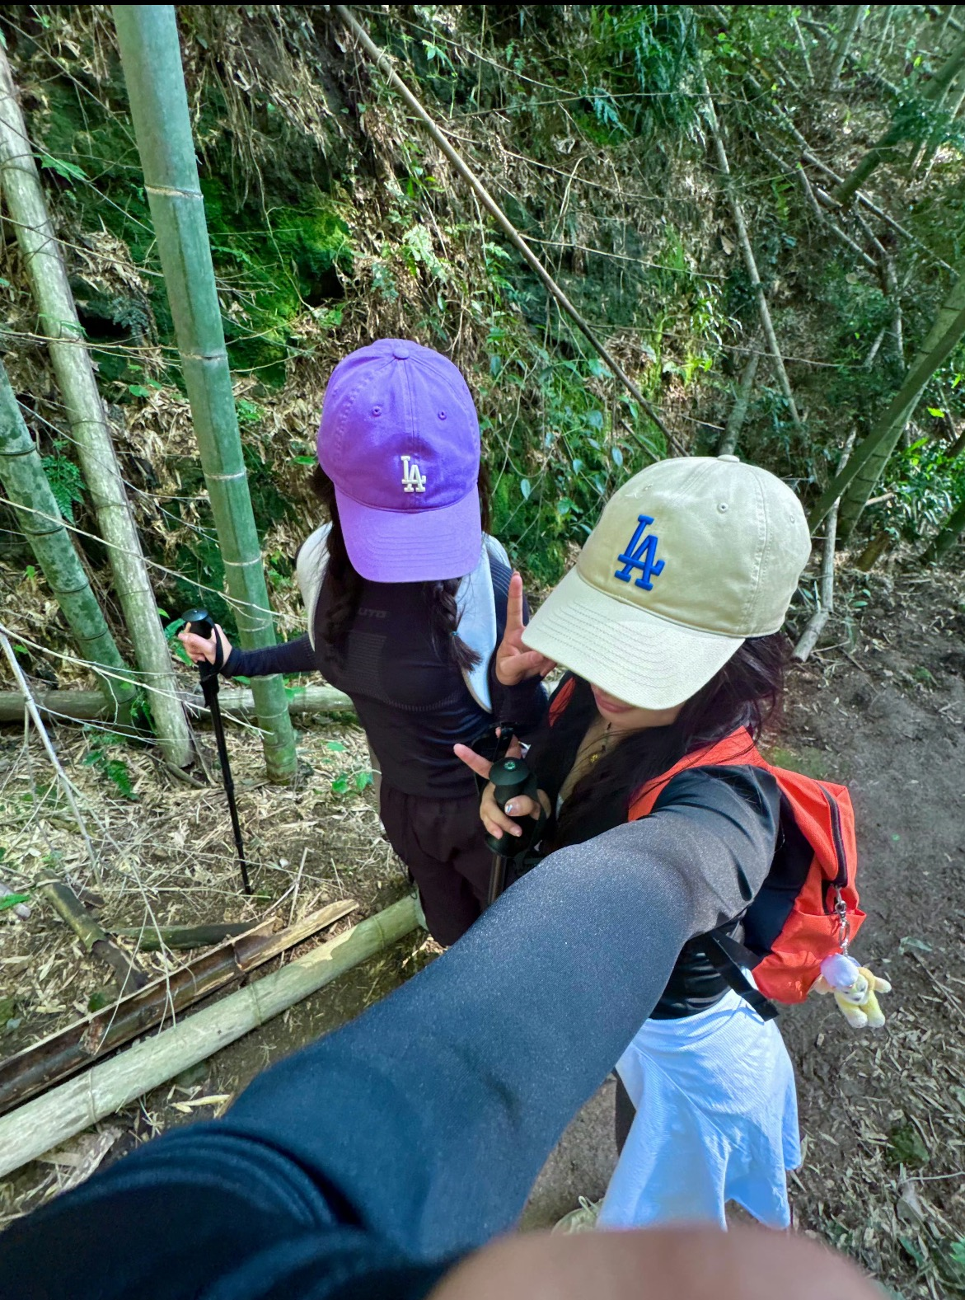
SLACK
LOOK FOR / UNICORNS BOX / xiaoshao

Slide 2
萧绍古道与青色的交响
Xiao Shao Ancient RoadSymphony
with Blue
青苔密径·文墨朝圣之路
江南水乡中的一条隐秘古道。南宋皇家御道遗址、
乾德四年的曹山寺等。千年兵道·历史烽烟遗韵
春秋战国时期，吴越争霸烽烟缭绕，在萧绍古道留下
历史遗韵。一足踏萧山，一足临绍兴。送梅记·录谢之烂
漫，待它再次华丽盛开！品种有“宫粉”“朱砂”
“绿萼”“玉蝶”“美人梅”等。
Moss Path: The Pilgrimage of Wenmo
A hidden ancient road in the water town of Jiangnan.
The Royal Imperial Road Site of the Southern Song Dynasty
and the Caoshan Temple in the fourth year of the Qianlongreign.Millennium Military Path: The Legacy of Historical Flames and SmokeDuring the Spring and Autumn Period and the Warring States Period, the smoke of war between Wu and Yue lingered, leaving a historical
legacy on the ancient path of Xiao Shao. One foot on Xiaoshan, the other foot on Shaoxing.Sending Plum Blossom Record: Record thesplendor of withering, waiting for it to bloom brilliantly again! There are varieties such as
"palace powder", "cinnabar", "green calyx",
"jade butterfly", "beauty plum", etc.

Slide 3

魔盒物语
Unicorns Box Tales
这是青色古典与史诗交错的文旅篇章
UNICORNS BOX Tales :
A Cultural Journey Where Verdant Antiquity
Meets Epic Tales .

Slide 4
文化亮点
Key Highlights
青苔密径·文墨朝圣之路
江南水乡中的一条隐秘古道。
南宋皇家御道遗址、
乾德四年的曹山寺等。
Moss-Covered Path · A Literary Pilgrimage
A hidden ancient trail nestled in Jiangnan’s
waterways, dotted with relics like the Southern Song
Imperial Trail and Caoshan Temple (est. 964 CE).
千年兵道·历史烽烟遗韵
春秋战国时期，吴越争霸烽烟缭绕，在萧绍古
道留下历史遗韵。一足踏萧山，一足临绍兴。
Millennium Military Path · Echoes of History
Once a strategic route during the Wu-Yue rivalry of the Spring and Autumn period (770–476 BCE), this trail breathes with legends of ancient battles. It straddles Xiaoshan and borders Shaoxing, embodying the spirit of two lands united by history.

Slide 5
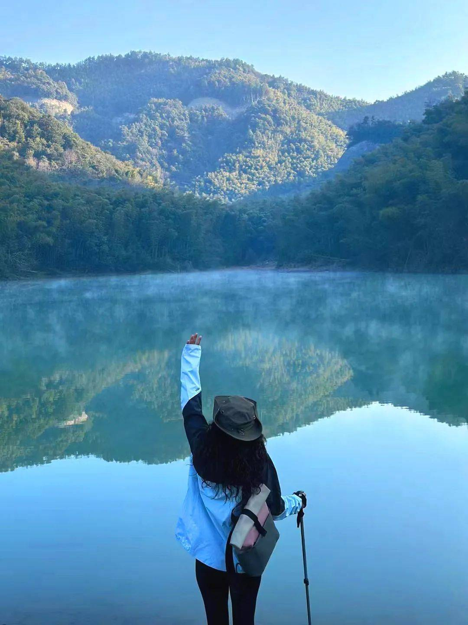
送梅记·记录凋谢之烂漫，待它再次华丽盛开！品种有“宫粉”“朱砂”“绿萼”“玉蝶”“美人梅”等。
Tales of Plum Blossoms · Celebrating
EphemeralBeauty A poetic ode to blossoms t
hat fade in fleeting brilliance, awaiting their grand revival! Varieties include *Gongfen* (Palace Pink), *Zhusha* (Cinnabar Red), *Lü’e* (Jade Calyx),
*Yudie* (Jade Butterfly), and
*Meiren Mei* (Beauty Plum).
SLACK

Slide 6
WE:「独角兽的魔盒」
我们将为各位热爱户外朋友们精心设计户外精途魔法线，不断推出盲盒惊喜单元，双语环境，中外友谊并肩同行，专业及安全服务相伴，独角兽携手大家一起守护正能量与纯洁。
WE: UNICORNS BOX
We craft magical outdoor adventure routes for nature enthusiasts, blending "blind box-inspired surprises" into every journey. Embrace bilingual exploration, cross-cultural camaraderie, and professional support for safety and joy. Join Unicorn in safeguarding nature’s
purity and sharing positive energy!

Slide 7
purity and sharing positive energy!

Slide 8
【程与诚】Itinerary: Journey of Sincerity
07:00 | 宜山路集合
07:00 | Gather at Yishan Road
07:30 | 准点出发，约3H到达。服务区调整（25min）上车领队宣讲。
07:30 | Depart promptly at 7:30 AM. The journey takes approximately 3 hours, including a 25-minute rest stop at a service area. Onboard briefing by the tour guide.
11:00｜抵达萧山
真诚相护开始旅程，萧山莲东村出发，首段是春秋越军夜袭吴国的密道，青石阶覆满苔痕。途中经过东晋云门寺、北宋曹山寺等，并在千年银杏下啜饮“越王禅茶”。随后登顶坎坡岭界碑，一脚踏萧山，一足临绍兴。
11:00 | Arrive in Xiaoshan
Embark on the "Journey of Sincerity," starting from Liandong Village. The first leg follows the ancient secret trail used by the Yue army during their night raid against the Wu Kingdom in the Spring and Autumn period, where moss-covered stone steps whisper tales of history. Pass through cultural landmarks such as the Eastern Jin Dynasty-era Yunmen Temple and Northern Song Dynasty-era Caoshan Temple. Pause to savor the "King Yue Zen Tea" beneath a thousand-year-old ginkgo tree. Ascend to the summit of Kanpo Ridge Boundary Monument, where you stand with one foot in Xiaoshan and the other in Shaoxing.
16:30｜抵达吉山梅园，感受梅花未，记录凋谢之烂漫。
16:30 | Arrive at Jishan Plum Garden
Immerse yourself in the ethereal charm of lingering plum blossoms, capturing the poetic beauty of fading petals.
18:30｜结束此次旅程，启程返沪。
18:30 | Conclude the journey and return to Shanghai.
【加入魔盒】[Join Us]
距离与时间：全长10KM，累计爬升约500m，预计时间3~3.5H
Distance and Time: Total length of 10KM, cumulative climb of about 500m, estimated time of 3-3.5H
难度：入门 风景度：四颗星 盲盒名额：免费与折扣 盲盒礼：周边礼品
Difficulty: Simple Scenery: Four Stars
Blind Box Quota: Five Stars Blind Box Gift: Blind Star
成团条件：14～30人起团

Slide 9
【费用信息】
交通：舒适豪旅大巴，司机路桥燃油停车等费用
物资：配备应急医疗物资
服务：全程双语领队，活动策划组织费用，
人身保障：户外高额30w保险
[Cost Information]
Transportation: Comfortable luxury bus, driver's road and bridge fuel parking fees, etc
Material: Equip with emergency medical supplies
Service: Full bilingual team leader, activity planning and organization fees,
Personal protection: Outdoor high-value 300000 yuan insurance
【注】
行程通知：最晚在出行前1天给您发送，如未收到请联系工作人员。集合时间、地点、服务人员等信息以《行程通知》为准。
预定限制：请有心脑血管疾病、心脏病史、孕妇及其余身体不便的人士避免参加户外徒步活动，请8～55岁之外的老人及未成年人在有监护人员的情况下参与，并将同行情况提前报备。
活动装备：本次活动为轻装徒步，建议携带登山杖、防滑鞋等基础装备。
需带宠物提前讲，并支付50元清洁费。
[Note]
Travel notification: We will send it to you no later than 1 day before departure. If you have not received it, please contact our staff. The gathering time, location, service personnel and other information shall be subject to the "Travel Notice".
Reservation restrictions: Individuals with cardiovascular and cerebrovascular diseases, a history of heart disease, pregnant women, and others with physical disabilities are advised to avoid participating in outdoor hiking activities. Elderly and minors aged 8-55 are required to participate with a guardian and report their travel status in advance.
Event equipment: This event is a light hiking, and it is recommended to bring basic equipment such as hiking poles and anti slip shoes
Pets must be brought in advance and a cleaning fee of 50 yuan must be paid

Slide 10
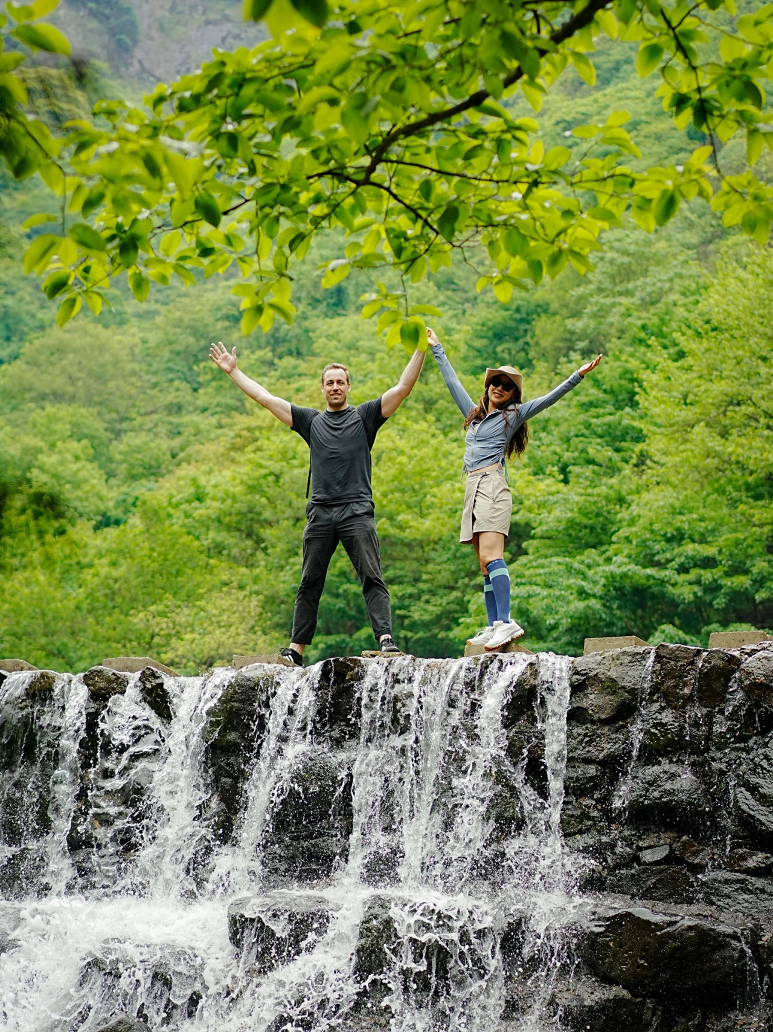
魔盒爱心
UNICORNS BOX’s LOVE
保护户外生态环境，请大家敬畏自然，不轻狂。让我们携手共创美好爱心box文明团，共勉之！
To protect the outdoor ecological environment, please respect nature and not be reckless. Let's work together to create a lovely and caring UNICORNS BOX Team, and encourage each other!

Slide 11

Unicorns BOX
Art nouveau
独角兽的魔盒
/
新艺术运动
your kingdom
你 的 王 国

